Slide 1
Object-Oriented Design
Assignment 1 (Use Cases)
By: Group 13
Nopphiphat Suraminitkul (Nopi)
Ayush Singh
Juhi Sinha
Somnath Jogelkar

Slide 2
List of Actors
System (Application): The job of the system is to grant all the actors, including the moderator, family & friends and movie server access/permission to execute use cases/tasks.
Moderator (Admin): Moderator is the actor who is taking care of all the administrative tasks. That includes inviting people to join a group, managing polls, populate movie list to name a few.
Friends & Family (Participants): We are combining both friends & family as one actor where they essentially serve as customers in the group. As a part of their functionality they shall join the group, browse the movies, vote for movies to name a few.
Movie Server API: An API to pull the movie list from. The movie server has the movie list that will be populated by the moderator.

Slide 3
List of Use Cases (Moderator)
Moderator creates group: The moderator shall create a movie watcher’s group.
Moderator sends invitation: The moderator shall send an invitations to family and friends to join the group that they are invited to.
Moderator pull movies list: The moderator shall extract a list of movies that the family and friends shall browse from an external movie server. It’s similar to the process of extraction in an ETL process
Moderator populate movie links: The moderator shall populate the movies list (including links) into the group which family and friends shall browse or search.
Moderator populate movie trailer links: The moderator shall populate the movie trailers links along with movies list into the group which family and friends shall browse or search and end up watching.
Moderator populate movie review links: The moderator shall populate the movie review links along with movies list into the group which family and friends shall browse or search and end up reading.
Moderator create movie watching event: The moderator shall create a movie watching event that already has a pre-specified date and time of movie screening.
Moderator opening polling periods: The moderator has the ability to set (open) polling time frame for a specific poll posted under a movie watching event.
Moderator closing polling periods: The moderator has the ability to set (close) polling time frame for a specific poll posted under a movie watching event.

Slide 4
List of Use Cases (Family & Friends)
Family & friends join group : Family & friends shall accept the invitation to join a group.
Family & friends unsubscribe from group : Family & friends shall be able to unsubscribe from the group.
Family & friends search movies : Family & friends shall be able to search a particular movie from the list of movies.
Family & friends watch trailers : Family & friends shall be able to watch a trailer after they select a particular movie from the list of movies.
Family & friends read movie reviews : Family & friends shall be able to view the review after they select a particular movie from the list of movies.
Family & friends get polling notification : Family & friends shall receive a polling notification for the list of movies.
Family & friends vote for movie : Family & friends shall be able to vote for a particular movie from the list of movies.
Family & friends modify vote : Family & friends shall be able to modify their votes until the polling period is open.
Family & friends get winner notification : Family & friends shall be notified of the movie that won the poll.
Family & friends access movie history : Family & friends shall be able to view the history of movies.

Slide 5
List of Use Cases (Movie Server)
Movie Server Grants Access to List of Movies: Movie Server gives access of the list of movies to the moderator

Slide 6
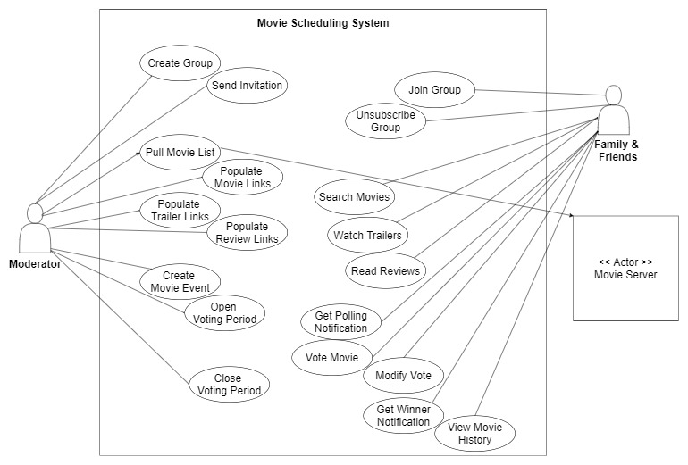
Use Case Diagram

